Slide 1
OS Concept Map 2 – May 14
Agenda
Module A.6 OS Concept Map
Discussion: Topic A – Application Software (OS Layers)
Discussion: Topic B – OS User Interface
Continue Level 1 Research
Catch-Up
See Spreadsheet for Missing / Incomplete Work
Upcoming
Tue, May 21st : OS Concept Map Due

Slide 3
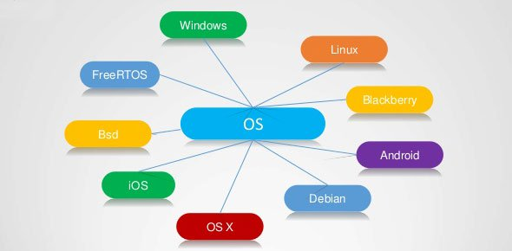

Slide 4
Topic A – Application & OS Layers
Computer Organization (Layers)
Hardware Layer
CPU
RAM
Memory
Display
Mouse /
Keyboard
DISKS

Slide 5
Topic A – Application & OS Layers
Computer Organization (Layers)
Application
(Program) Layer
MS Word
(Office)
Chrome
(Web)
Photoshop
(Media)
Other Apps
Hardware Layer
CPU
RAM
Memory
Display
Mouse /
Keyboard
DISKS

Slide 6
Topic A – Application & OS Layers
Computer Organization (Layers)
Application
(Program) Layer
MS Word
(Office)
Chrome
(Web)
Photoshop
(Media)
Other Apps
High End Game
Operating
System Layer
(Software)
Task
Scheduler
Memory
Allocation
Device
Manager
Display Control
I/O Interrupts
Hardware Layer
CPU
RAM
Memory
Display
Mouse /
Keyboard
DISKS

Slide 7
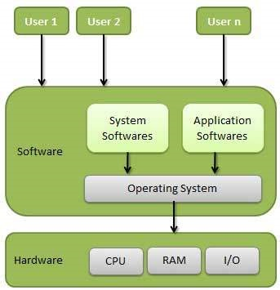
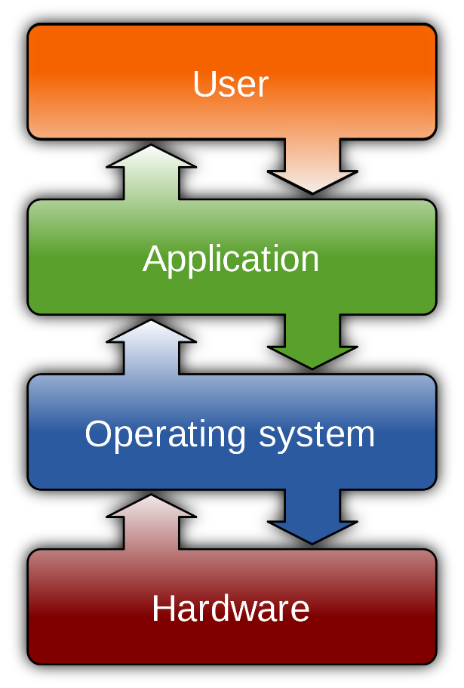

Slide 8
Topic A – Application & OS Layers
Common Computer Tasks (Operations)
E.g. Open A Program
Application
(Program) Layer
MS Word
(Office)
Chrome
(Web)
Photoshop
(Media)
Other Apps
Operating
System Layer
(Software)
Task
Scheduler
Memory
Allocation
Device
Manager
Display Control
I/O Interrupts
Hardware Layer
CPU
RAM
Memory
Display
Mouse /
Keyboard
DISKS

Slide 9
Topic A – Application & OS Layers
Common Computer Tasks (Operations)
E.g. Open A Program
Application
(Program) Layer
MS Word
(Office)
Chrome
(Web)
Photoshop
(Media)
Other Apps
Operating
System Layer
(Software)
Task
Scheduler
Memory
Allocation
Device
Manager
Display Control
I/O Interrupts
Hardware Layer
CPU
RAM
Memory
Display
Mouse /
Keyboard
DISKS

Slide 10
Topic A – Application & OS Layers
Common Computer Tasks (Operations)
E.g. Typing Some Text
Application
(Program) Layer
MS Word
(Office)
Chrome
(Web)
Photoshop
(Media)
Other Apps
Operating
System Layer
(Software)
Task
Scheduler
Memory
Allocation
Device
Manager
Display Control
I/O Interrupts
Hardware Layer
CPU
RAM
Memory
Display
Mouse /
Keyboard
DISKS

Slide 11
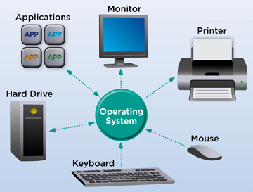

Slide 13
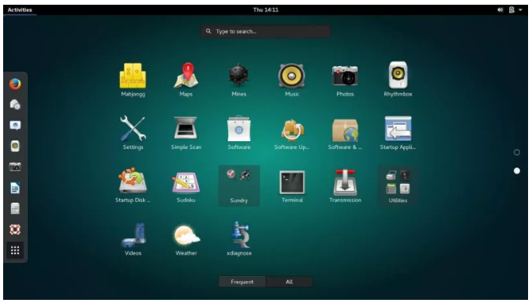

Slide 14
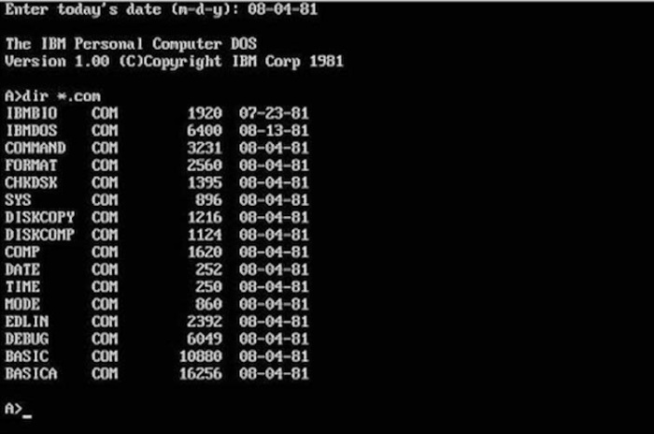
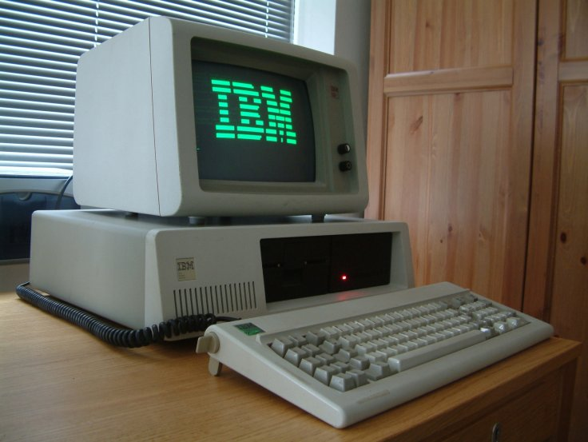
Topic B – Window Interface
Early Computers (DOS Based)
Command Line (Console)
One Program At A Time
Full Screen Display
No Mouse

Slide 15
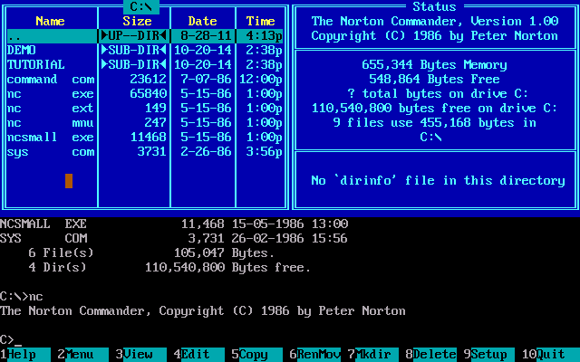
Topic B – Window Interface
Norton Commander / DOS Shell
Runs as a “Shell” on top of DOS
Still Full Screen / Text Based (No Mouse)
Still One Program At A Time
Added the Ideas of:
Menu Items
Hot Keys
Visual Organization
Improved the:
management of files
Speed of accessing and opening applications

Slide 16
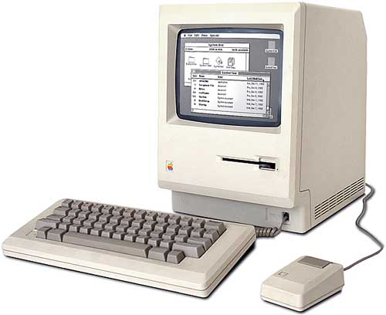
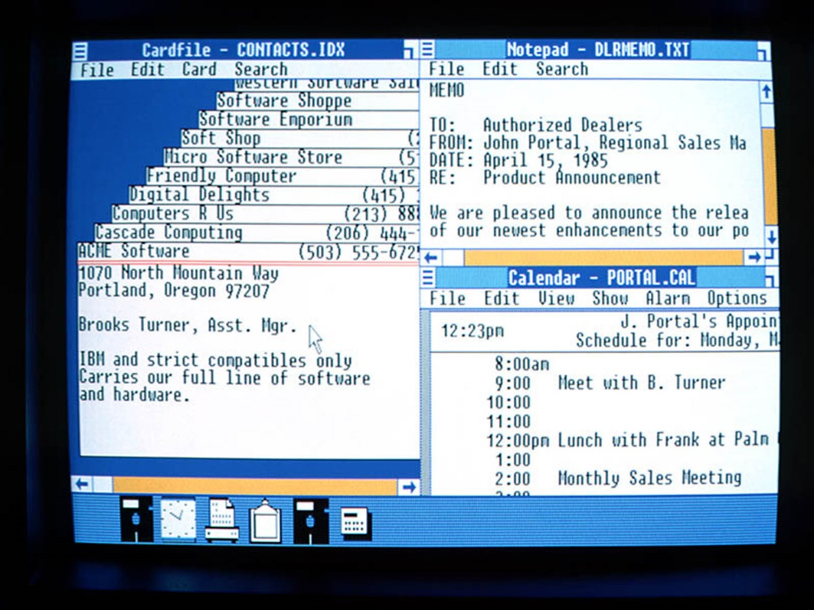
Topic B – Window Interface
Windows 1.0 / Macintosh (1985)
First mouse based interface
Applications open in own window
Widgets / Dialogues / Drop Down Menus
Many Program At A Time
Icons!
Trash Can!

Slide 17
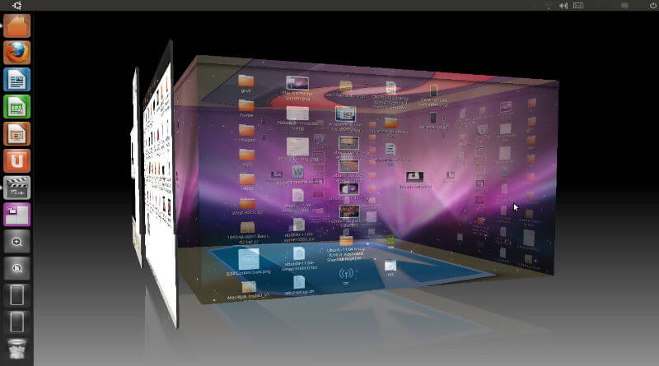
Topic B – Window Interface
Modern Graphical User Interface (GUI)
Multiple Workspaces / Accelerated Graphics
Touch Screen Interface
Network
Wide Reach

Slide 19
Assignment Overview
Objective:
To learn about the key parts of a software operating system (OS)
Process:
Level 1 : Rough Research
Level 2 : Organized Research
Level 3 : Final Concept Map
OS Topics:
Windows
Mac OS
Linux
Android
iOS

Slide 20
Important To Do
I will be marking the PROCESS as well as the PRODUCT.
Level 1 : Rough Research
I need to see content in this area!!!
Cut and paste rough research notes as you go.
Level 2 : Organized Research
I need to see stuff from Level 1 appear here!!!
Organise your rough research into common ideas
Reduce duplicated information
Re-word into your own voice
Level 3 : Concept Map
Select only the most important stuff from Level 2
Summarize into short bullet points
You will be MARKED DOWN if concept map is rust a repeat of Level 2

Slide 21
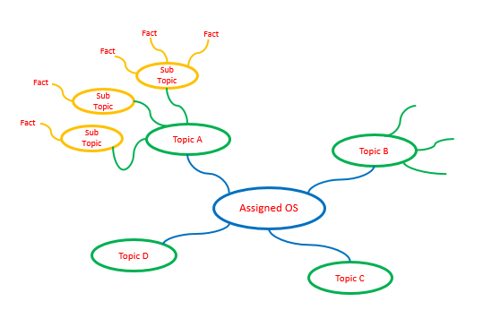
Concept Map
Use PowerPoint or another application of your choice.
Submit as PDF or Image File

